Slide 1
Project III: Merging pdfs
Presented by :
Karan singh bisht
19-CSE-45(19015004008)

Slide 2
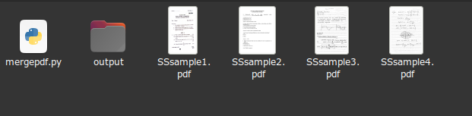
TAKING SAMPLE INPUT
THESE ARE THE 4 INPUT SAMPLE PDF WHICH WHICH WE ARE GOING
TO WORK ON WE ARE USING THE OS MODULE AND PYPDF2 MODULE
IN THIS PROJECT AND USING IT FUNCTIONALITY AND UNDERSTANDING
THE MODULE IN DETAIL
BY USING PYTHON SCRIPT

Slide 3
Introduction
PDF stands for Portable Document Format. It uses.pdf extension. This type of file is mostly used for sharing purposes. They cannot be modified, thereby preserving the formatting of the file intact. Hence they can be easily shared and downloaded. They are meant for reading and not editing. They look similar on any device they are opened independent of the hardware, software, and operating system.

Slide 4
Some Common Libraries for PDFs in Python
There are many libraries available freely for working with PDFs:
1. PDFMiner: It is an open-source tool for extracting text from PDF. It is used for performing analysis on the data. It can also be used as a PDF transformer or PDF parser.
2. PDFQuery: It is a lightweight python wrapper around PDFMiner, Ixml, and PyQuery. It is a fast, user-friendly PDF scraping library.
3. Tabula.py: It is a python wrapper for tabula.java. It converts PDF files into Pandas’ data frame and further all data manipulation operations can be performed on the data frame.
4. Xpdf: It allows conversion of PDFs into text.

Slide 5
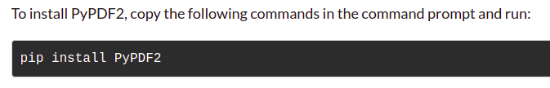
5. pdflib: It is an extension of the poppler library with python bindings present in it.
6. Slate: It is a Python package based on the PDFMiner and used for extraction of text from PDF.
7. PyPDF2: It is a python library used for performing major tasks on PDF files such as extracting the document-specific information, merging the PDF files, splitting the pages of a PDF file, adding watermarks to a file, encrypting and decrypting the PDF files, etc. We will use the PyPDF2 library in this tutorial. It is a pure python library so it can run on any platform without any platform-

Slide 6
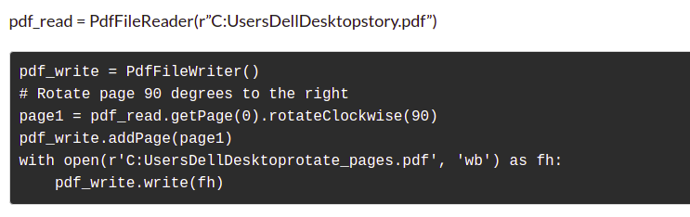
Merging PDF files in Python
This is the simple formating how you can use this method via pyPDF2

Slide 7
Things You Can Do With PyPDF2
Getting the document details
Extracting Text from PDF
Rotating the pages of a PDF
Merging PDF files in Python
Splitting the pages of PDF
Encrypting a PDF file
Adding a Watermark to the PDF file

Slide 8
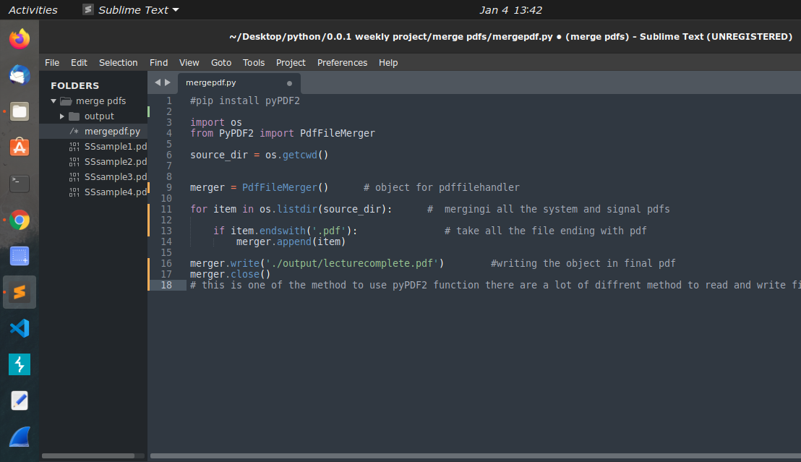
Code :
mergepdf.py :file for combining the pdfs into one

Slide 9
Whats happening in the code
We are importing the required modules
Creating an object for PdfFilemerger() function
Running the loop in the file directory
Taking the condintion for all the file ending with (“pdf ”)
Appending it in a single unit
And writing all that data into final pdf

Slide 10
Why this project
We have a lot of study material available these days in online classes and all that is send random time
So at the time of exams its gets difficult to arrange that many pdfs in diffrent files
So this project collect all the data at create a new file having all the data

Slide 11
Refrences
https://www.analyticsvidhya.com/blog/2021/09/pypdf2-library-for-working-with-pdf-files-in-python/
https://www.geeksforgeeks.org/working-with-pdf-files-in-python/

